Slide 1
Student Management System
Sadia Saeed (22-NTU-CS-1219) Shehar Bano (22-NTU-CS-1222)

Slide 2
Introduction:
Our student management system is a software tool designed for educational institutions to easily handle student-related tasks. It allows schools and colleges to enroll students, view their information, add new courses, and record attendance. This system simplifies the management of student data, making it more efficient for teachers and administrators to oversee academic activities.

Slide 3
Main Features:
These are the main features of our student management system:
1. Student Module:
Enroll Students
Display Student Information
View Registered Courses
Enroll in Courses
2. Course Module:
Add Courses
Display All Courses
Take Attendance
These features collectively enable educational institutions to efficiently manage student data, course information, and attendance records, simplifying administrative tasks and enhancing the overall educational experience.

Slide 4
Tools and Technologies Used:
Visual Studio:
For C#.
For Window Form.
Microsoft SQL Server:
For SQL. (Data Storage)

Slide 5
Entities for Student Management System:
In our Student Management System, there are several entities that play a crucial role in managing student data and courses. Here are the main entities:
1. Student:
Attributes include student ID, First Name, Last Name and enrollment status.
2. Course:
Attributes include course ID, course name, and Teacher Name.
3. Enrollment:
Contains information about which students are enrolled in which courses.
4. Attendance:
Contains information about which students attended a particular class on a given date.
These entities form the core of your Student Management System, allowing you to effectively manage student data, course information, enrollment records, and attendance tracking.

Slide 6

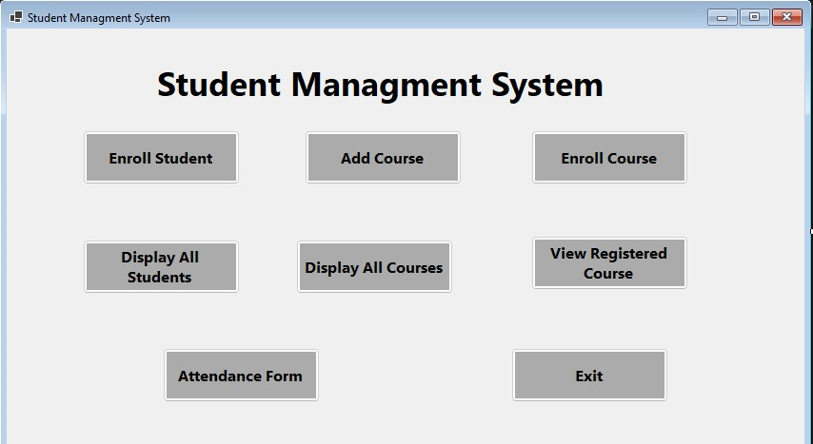

Slide 7
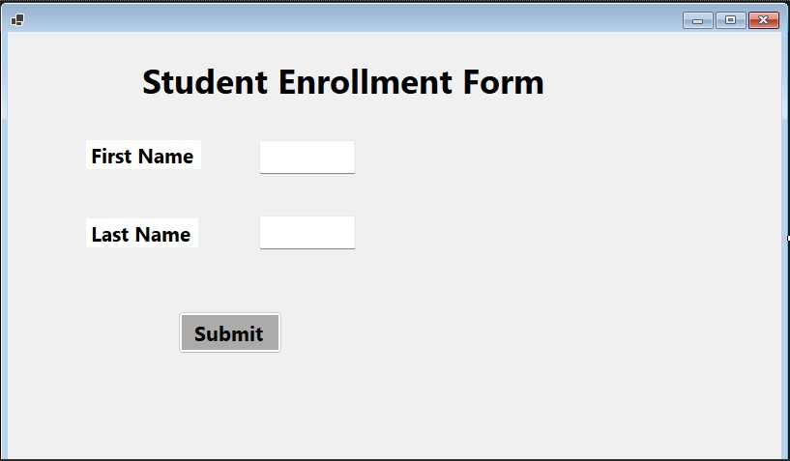

Slide 8
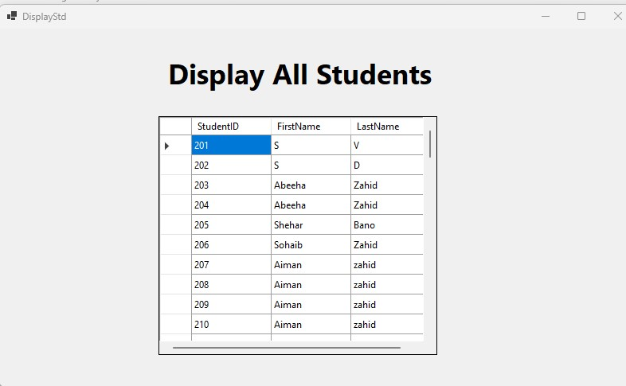

Slide 9
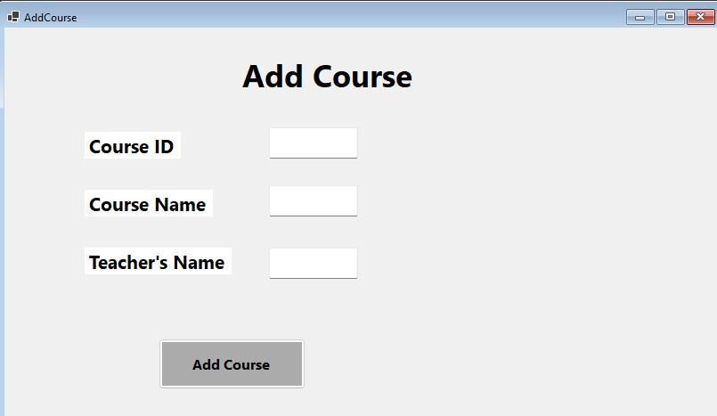

Slide 10
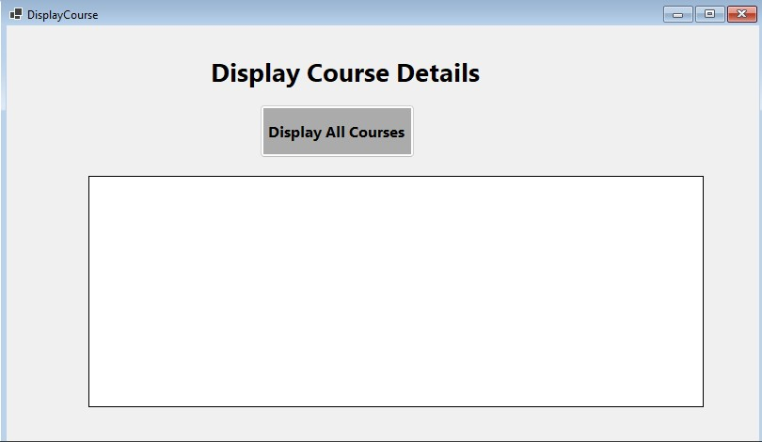

Slide 11
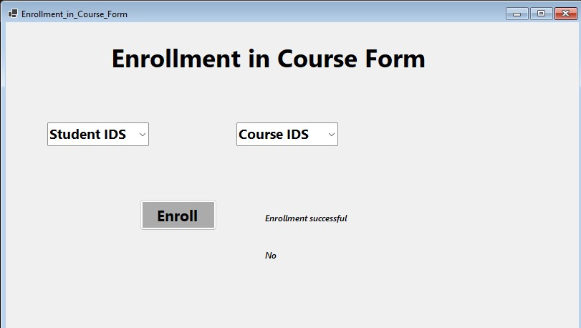

Slide 12
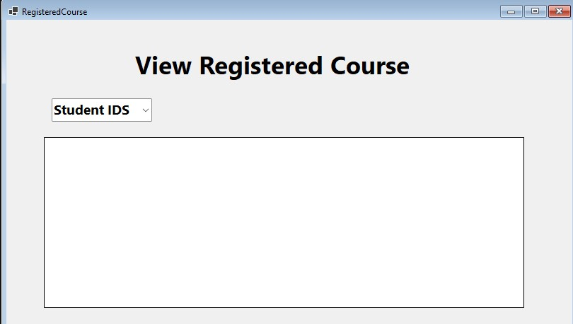

Slide 13
